Slide 1
How to create a help desk ticket

Slide 2
Go to the ESGVROP MyTechDesk Site by clicking the link below, or copy and paste it into your web browser
Click sign in to your team or register for a new account (reset your password if you forgot your password).
***If you need to register for a new account please contact Joe Beaudion at jbeaudion@esgvrop.org or Nabrina Flick at nflick@esgvrop.org to obtain the team password.
https://app.mytechdesk.org/team/east_sgv_rop

Slide 3
SELECTING THE CORRECT TEAM
Once you are successfully signed in to MyTechDesk, please make sure that the tickets you create are being sent to the correct team.
There are three teams in MyTechDesk:
Tech Team
Please direct any technology related tickets to the Tech Team. For example, requests to check on printer problems, computer issues, software issues and updates, etc…
Maintenance Team
Please direct any maintenance issues to the Maintenance Team. For example, issues with facilities, need for toiletries, need for busses, etc…
Reprographics Team
Please send all request for large copies to the Reprographics team.

Slide 4
SELECTING THE CORRECT TEAM
You will see a drop down arrow in the upper right hand side of the page once you’re logged into mytechdesk. This is where you can select the correct team to direct your ticket. If you do not have three teams to choose from, please contact Joe Beaudion at jbeaudion@esgvrop.org

Slide 5
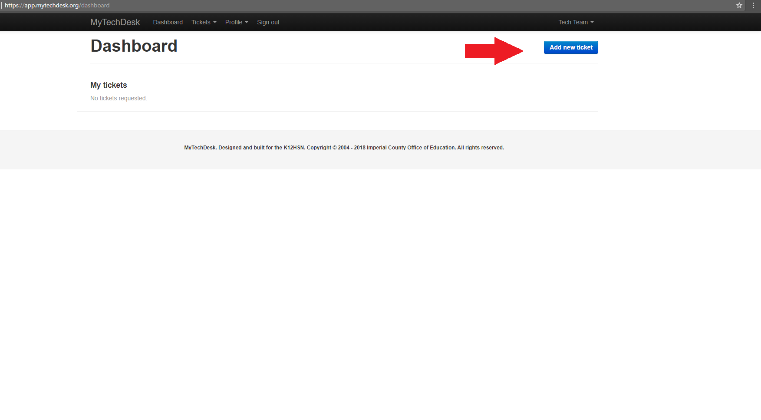
ADDING TICKETS

Slide 6
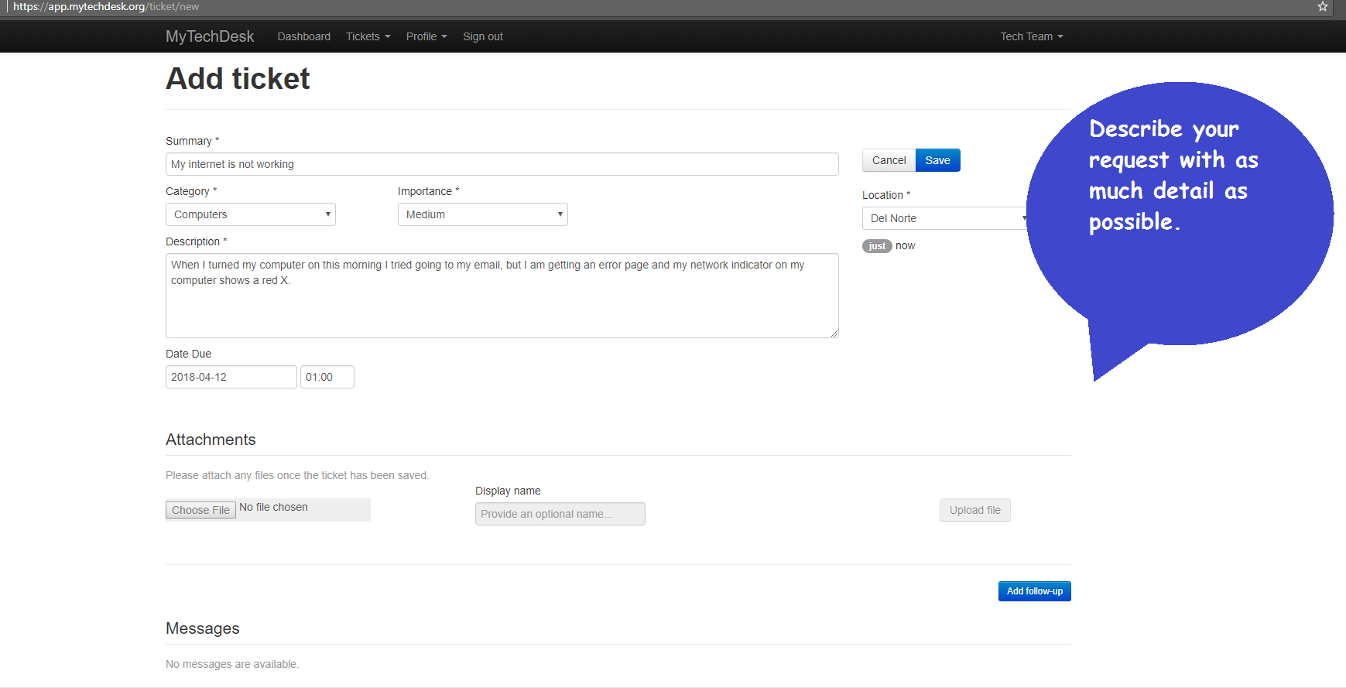
DESCRIBE YOUR REQUEST

Slide 7
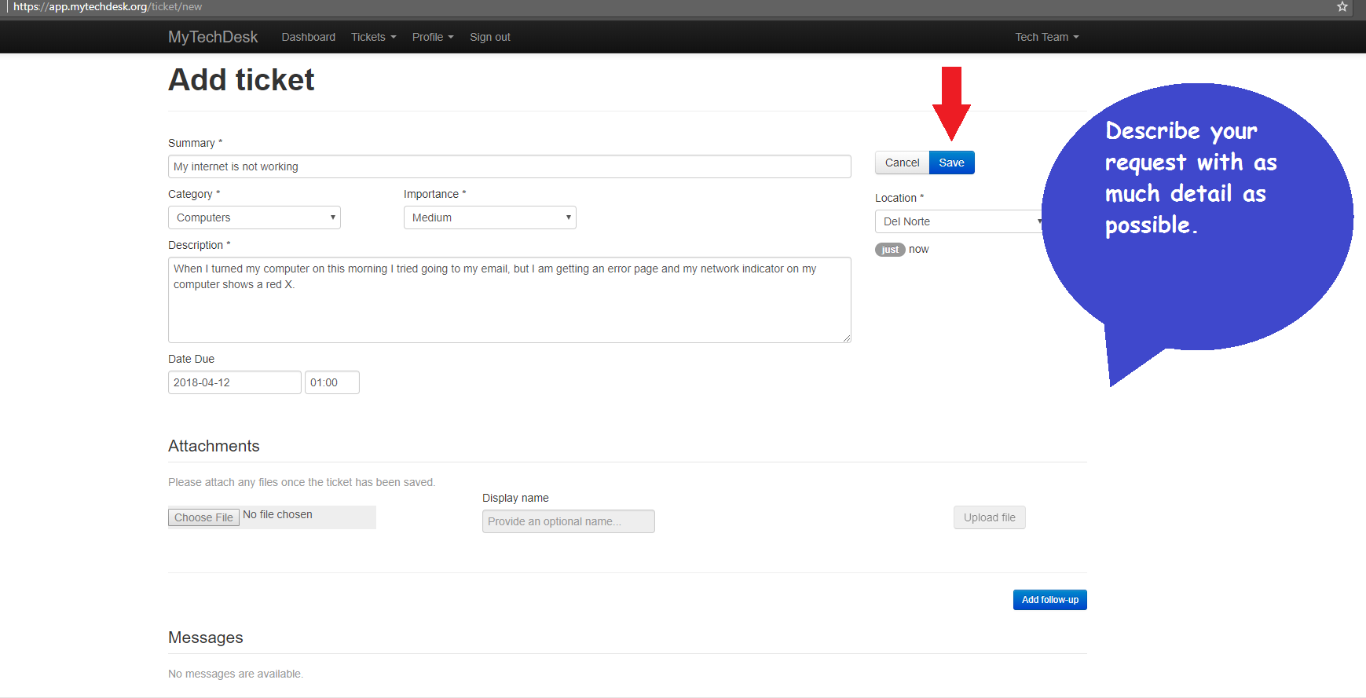
SAVE YOUR REQUEST

Slide 8
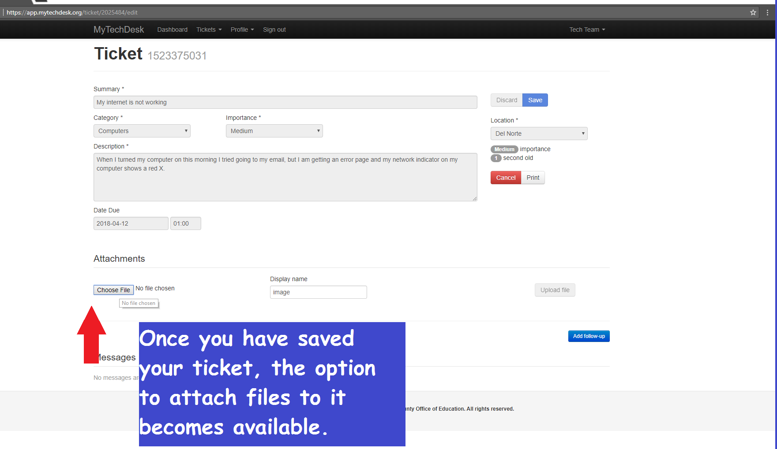
ATTACHING FILES TO YOUR REQUEST

Slide 9
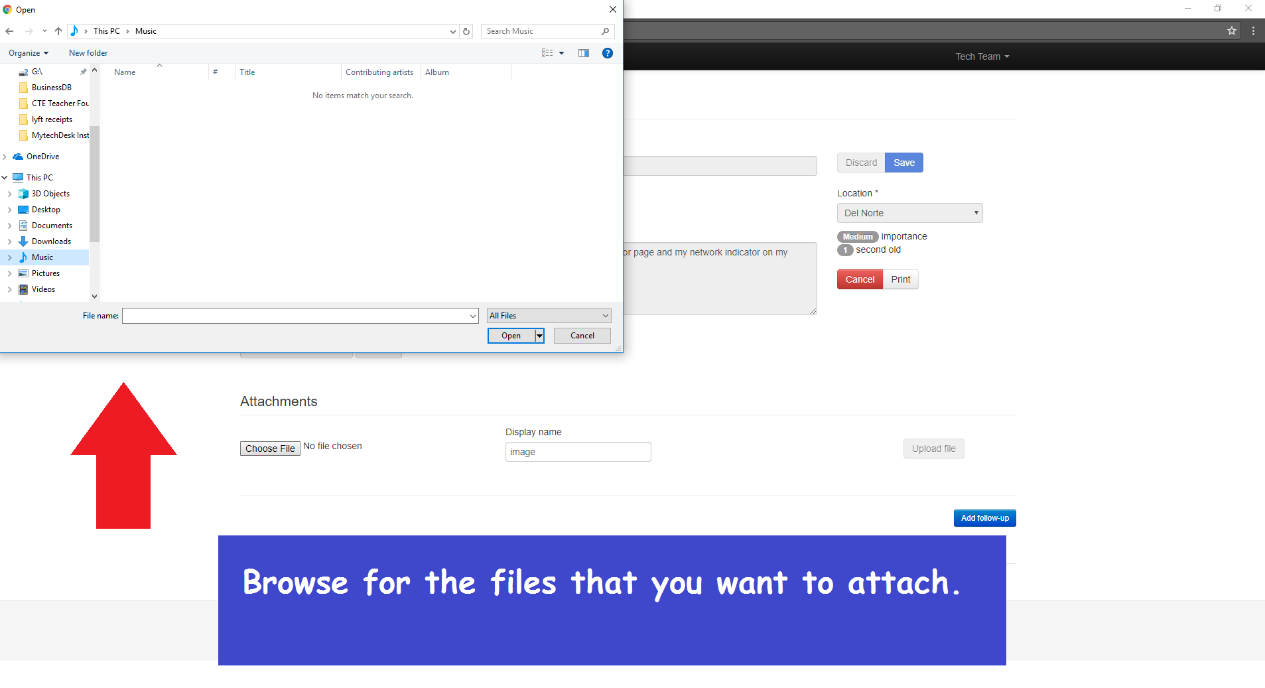
LOCATE THE FILE THAT YOU WISH TO ATTACH

Slide 10
***For further assistance please contact Joe Beaudion at jbeaudion@esgvrop.org or Mauricio Centeno at mcenteno@esgvrop.org

